Slide 1







Helping in the journey to a healthy Motherhood
Healthy Mom + Baby Datapalooza
We R Family
Anjali Hegde
Snehalatha Doddigarla
Srishti Bisen
Sukhsagar Jaiswal
Vikas Das

Slide 2

Agenda
Executive Summary
Analysis
Symbiosis
R-shiny App
Plans of action
Prenatal and Postnatal strategies to combat infant mortality

Slide 3

Facts
Infant mortality in Indiana was 7.2 deaths per 1000 births in 2017
Indiana has the 7th highest infant mortality rate in the US
2
Notes:
source

Slide 4




Executive Summary
Objective
To reduce infant mortality in Indiana
Challenge
Solution
Solution
Use data analytics to deliver powerful insights on the causes of infant mortality
Implementation
Identify women in early stages of problematic pregnancies using R-Shiny app and provide personalized guidance to improve health outcomes for Indiana's mothers and infants
Utilize the identified parameters to allocate resources optimally to achieve better success with OB Navigator program
Implementation
3
Notes:
exploration and analysis of Indiana’s data to deliver powerful insights and innovative solutions

Slide 5

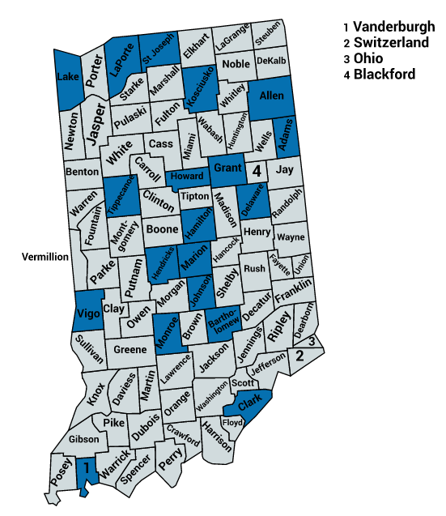
Analysis
01
Half the state’s infant deaths in 10 counties
The top 10 counties contributing to 55 % of the Infant Deaths include Marion, Lake, Allen, St Joseph and Elkhart in top 5
County map of Indiana
02
Average population has varying effects
Marion, has 20 % of total infant deaths; although Marion has roughly twice the population of the second largest county, its Infant deaths are almost thrice!
03
Marion has a lot of OBGYN providers
Marion, which makes up ~15% of total Indiana population, has nearly 30% of total OBGYN providers in Indiana
04
Disproportionate distribution of OBGYN providers
Counties that have almost half the population as Marion have only 6-9% of the total OBGYN providers
5
https://hub.mph.in.gov/dataset

Slide 6
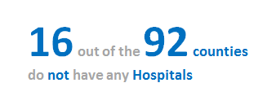
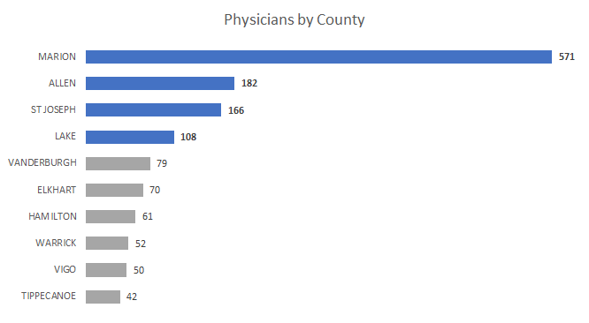
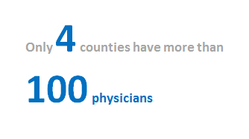
~17% of the counties do not have hospitals, with only four counties having more than hundred physicians
Marion, Allen, St. Joseph and Lake have the highest number of physicians available are also among top 10 counties with highest IMR
https://hub.mph.in.gov/dataset
6

Slide 7
Lack of Inpatient Delivery Services and Pregnancies before 18 years of age are few of the major reasons for high Infant mortality rates in Indiana
Mothers in age groups 15-18 Years and 14 Years and Under are most susceptible to infant mortality and need to be identified early in their pregnancies
Awareness programs needs to initiated among people about sexual health to avoid unwanted pregnancies and pregnancies before 14 years
33 out of the 92 counties
do not have any Inpatient Delivery Services available
https://hub.mph.in.gov/dataset
7

Slide 8
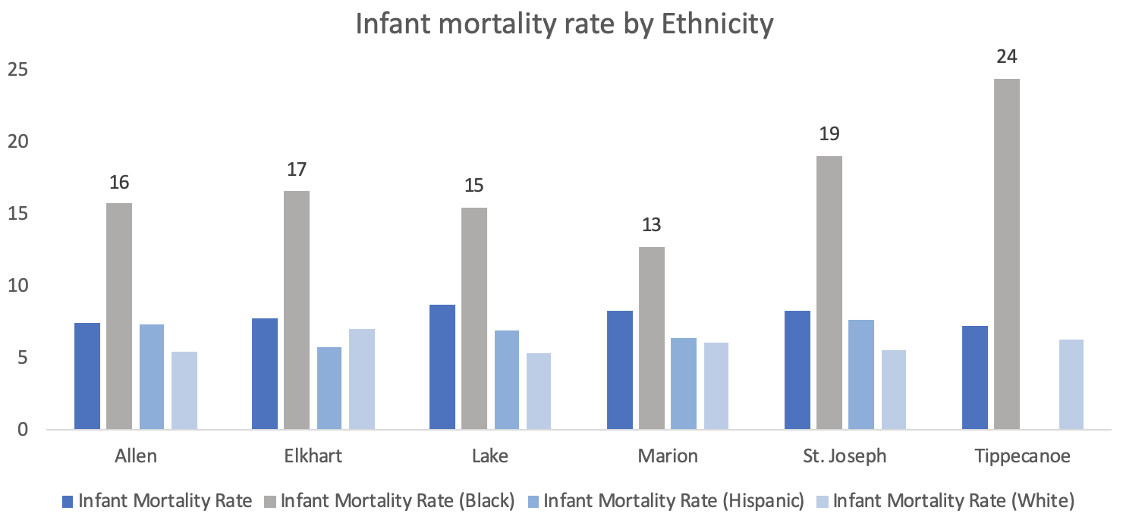
Infant Mortality by ethnicity
The rate of infant mortality for babies of black ethnicity is more than twice the rate for babies of white ethnicity
The highest IMR for babies of black ethnicity is seen in Tippecanoe, followed by St. Joseph, Elkhart, Allen, Lake and Marion respectively
https://hub.mph.in.gov/dataset
8

Slide 9
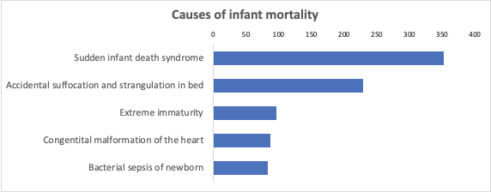
The leading cause of Infant Mortality is Sudden infant death syndrome that makes 30% of all infant deaths
The most common causes of SIDS and Accidental Suffocation are:
Brain Defects and Respiratory Infections
Premature birth
Harmful sleep environmental factors
A4
https://hub.mph.in.gov/dataset

Slide 10








Symbiosis of R-Shiny app and OB-Navigator
Healthcare Provider
Indiana State Health Dept
Pregnant Mother
OB Navigator
R-Shiny App
Access to healthcare
Mother health
Resources available
Baby health
https://www.in.gov/isdh/28233.htm
Critical County

Slide 11
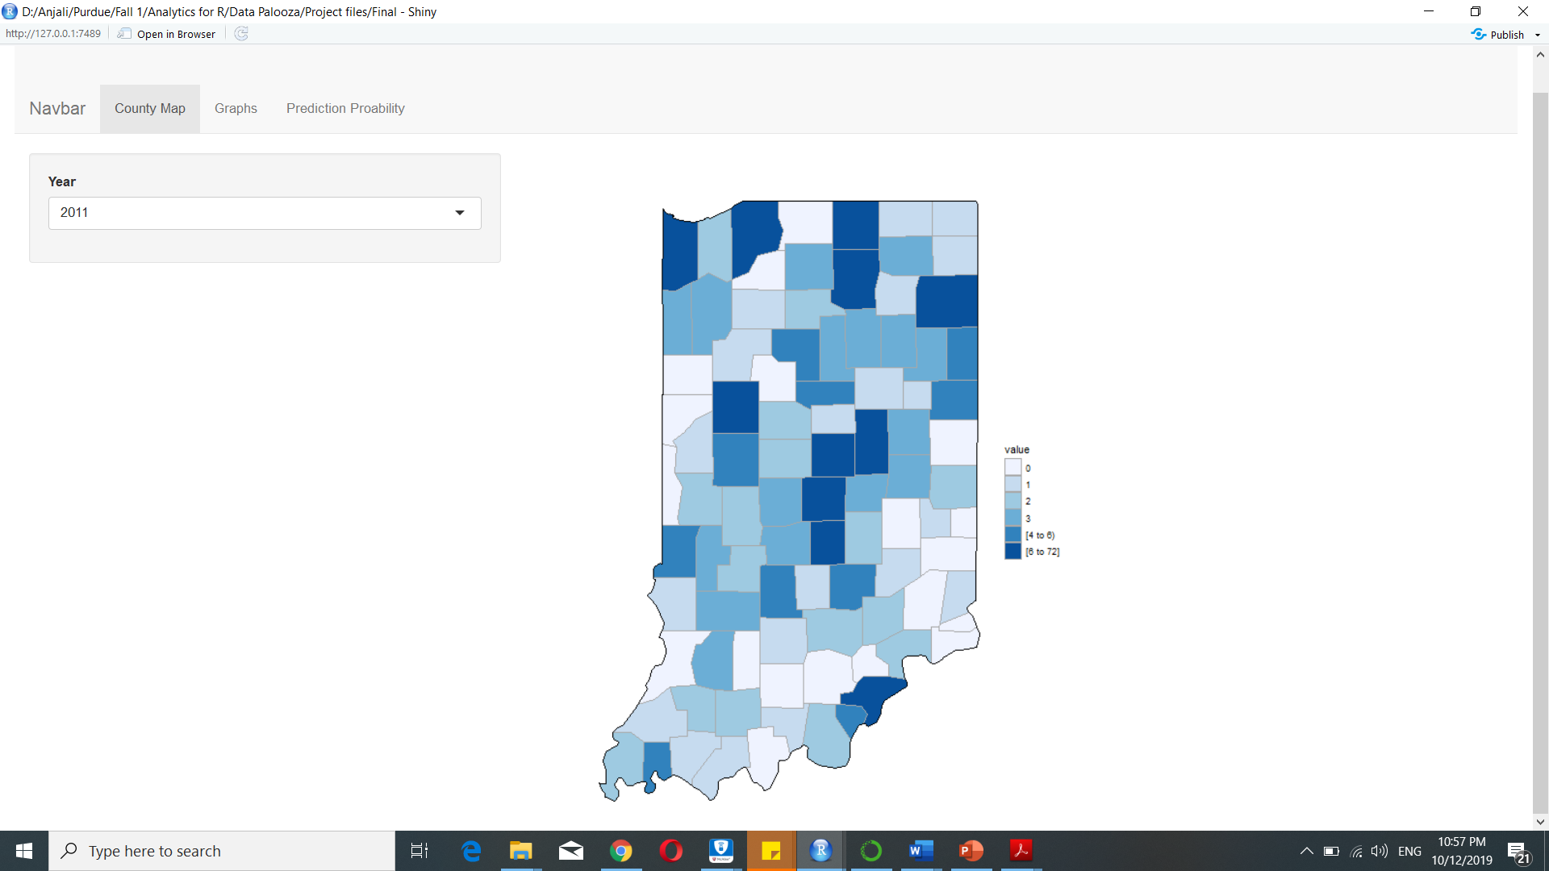
R-Shiny App
Infant mortality rate by year for each county
10

Slide 12
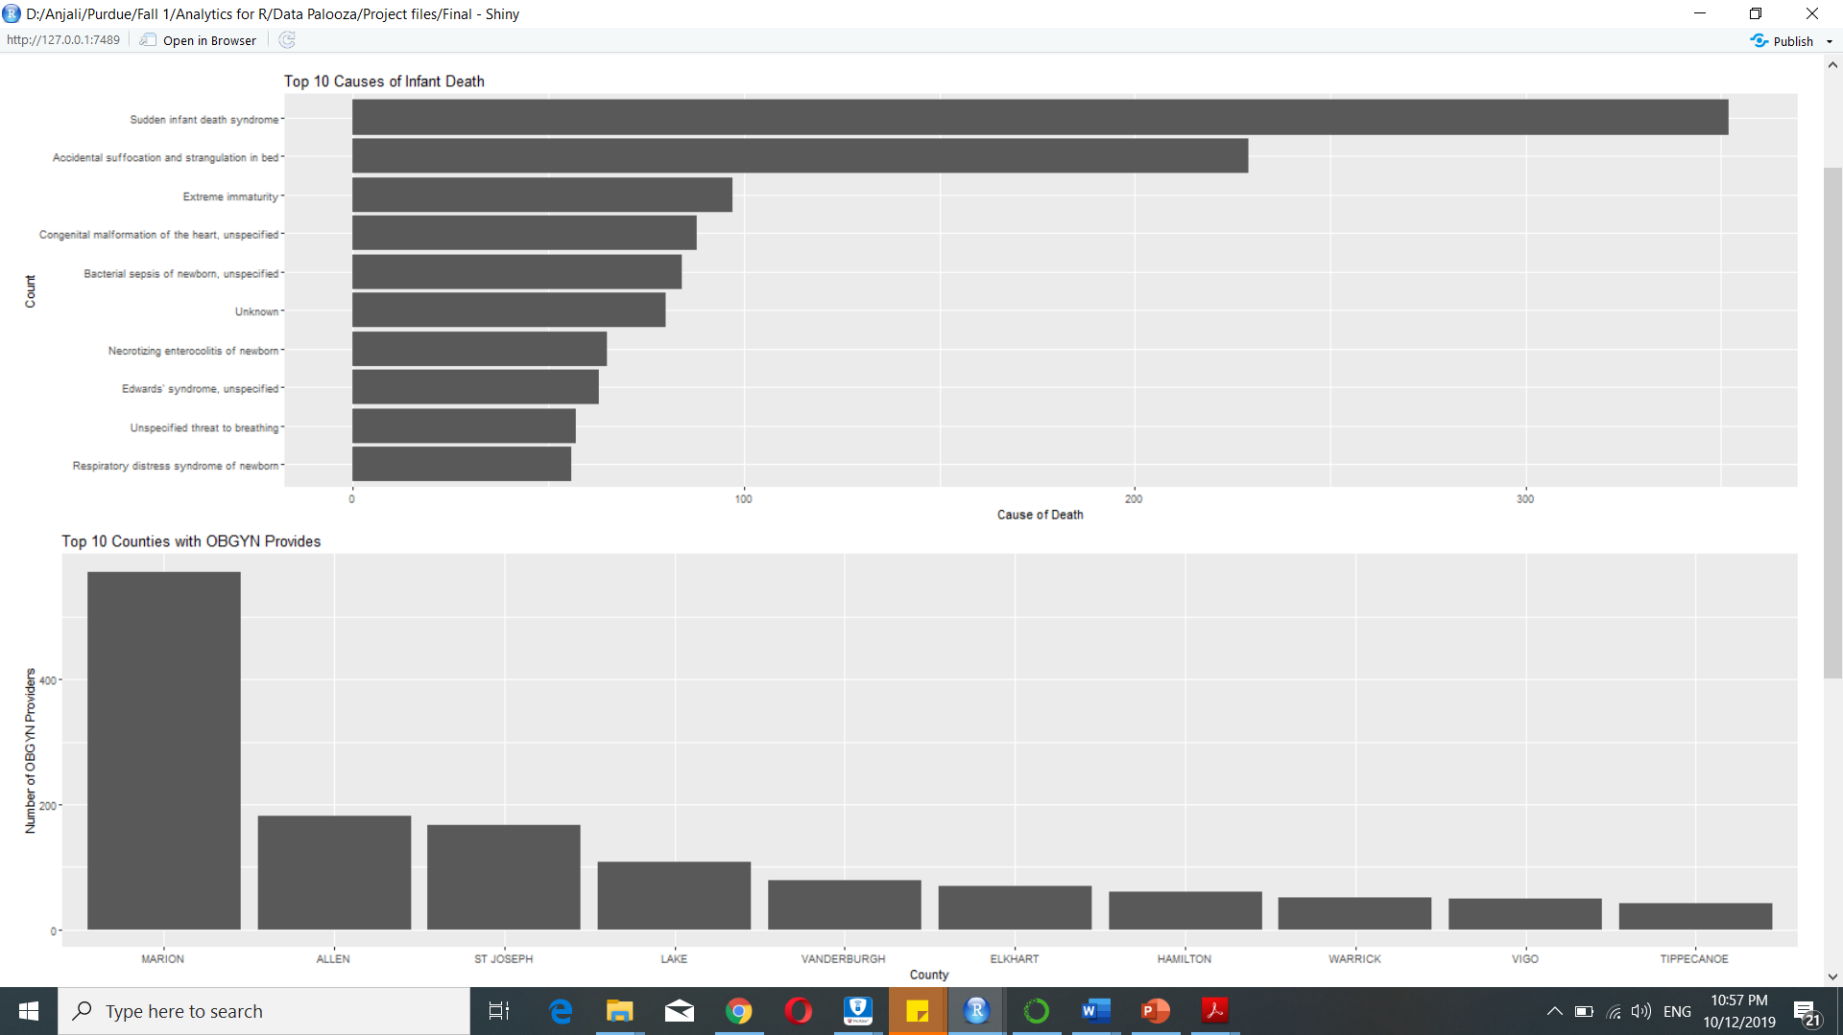
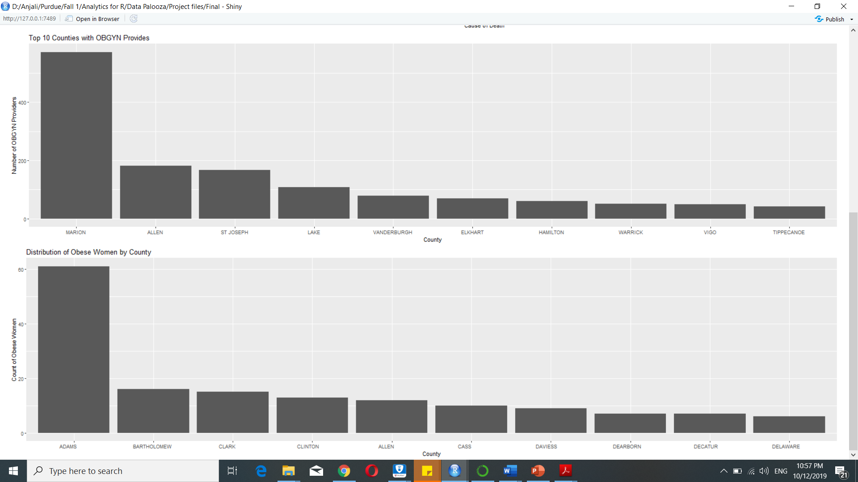
R-Shiny App
Top 10 causes of infant mortality
Top 10 counties with OBGYN providers
Distribution of obese women by county

Slide 13
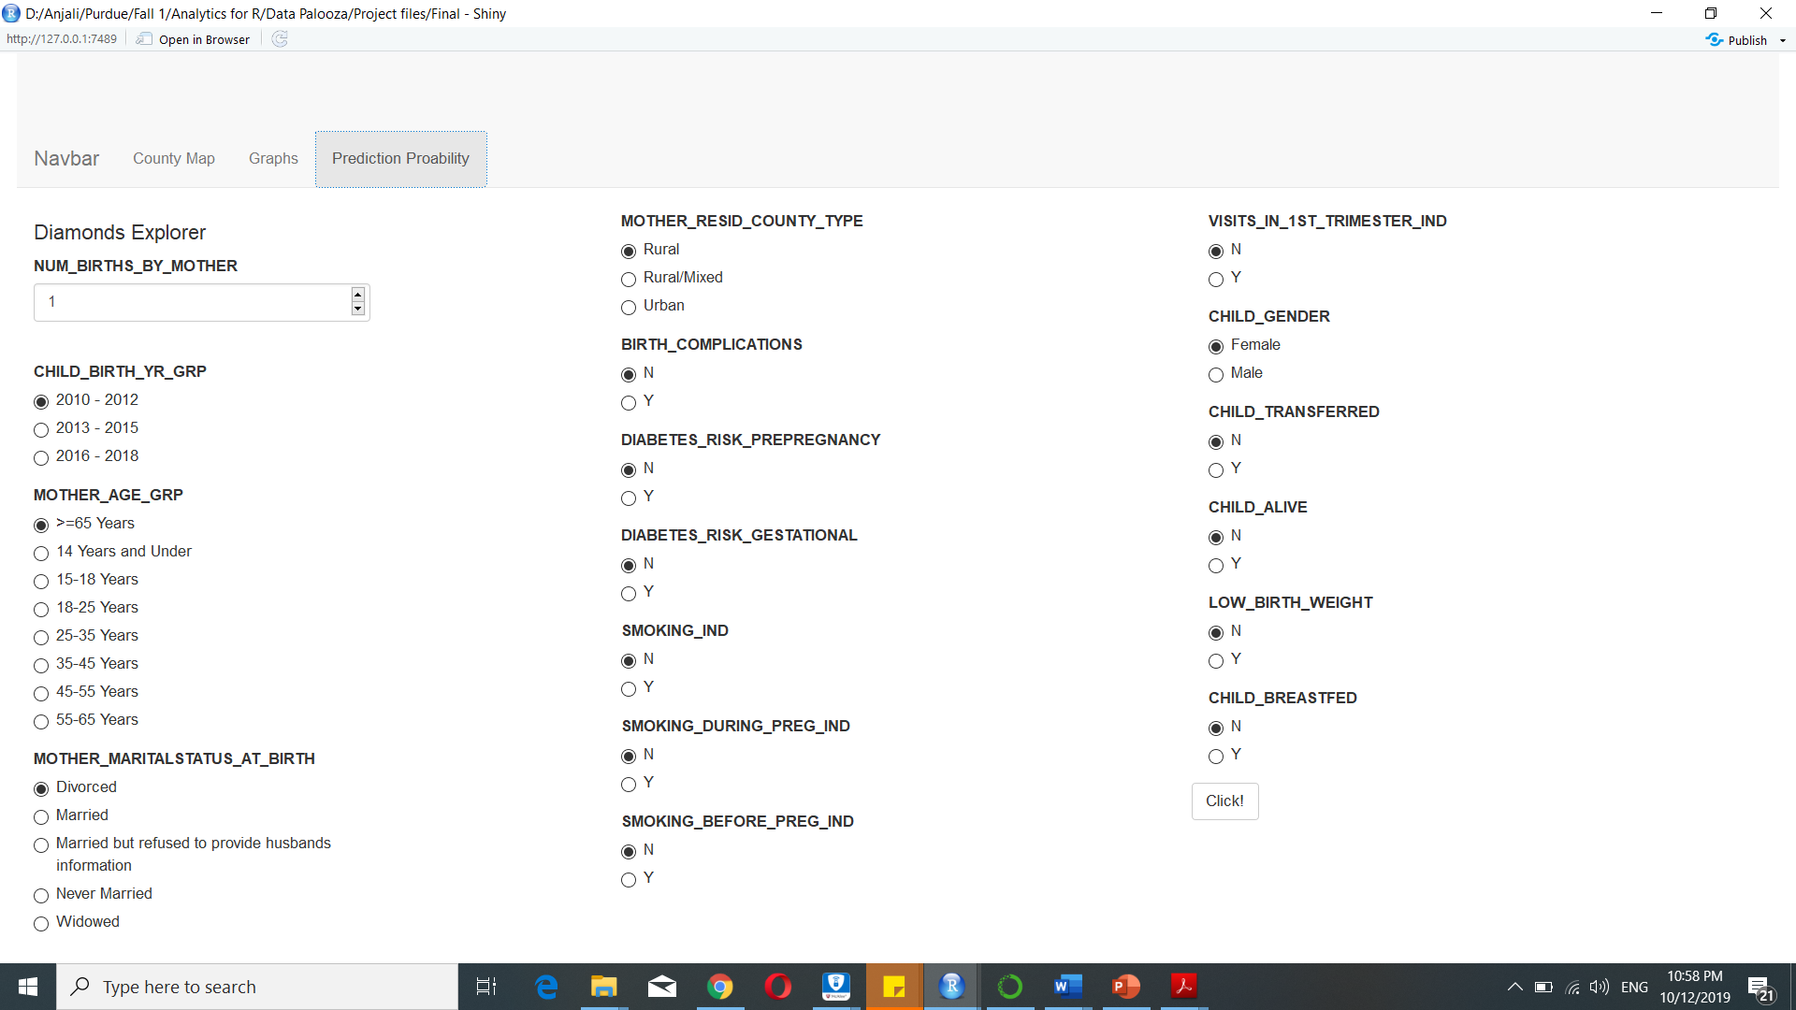
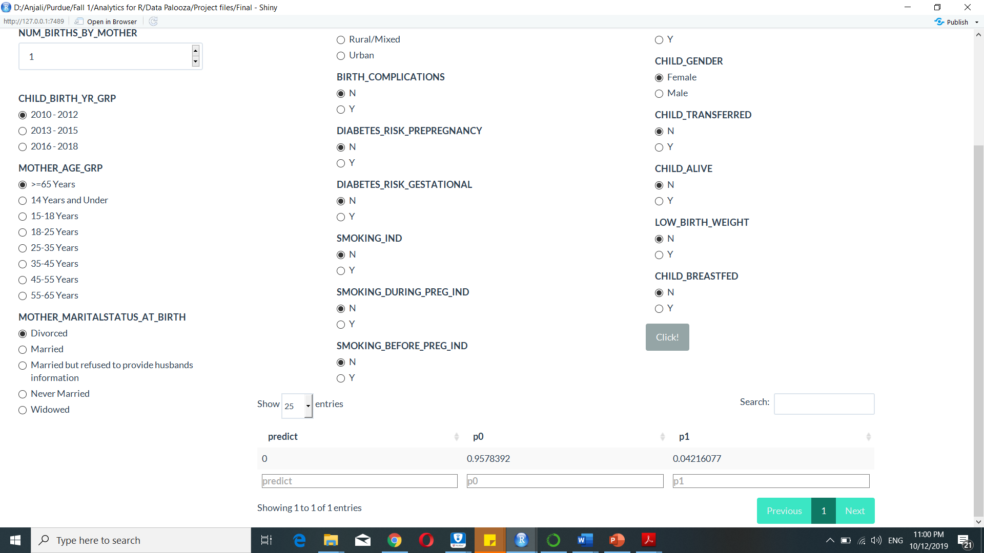
Predicting probabilities of infant mortality with different parameters
Provides insights about variables that significantly lead to infant mortality

Slide 14



Plan of action:
Challenge
Short-term solutions
Awareness programs:
Implement with assistance of organizations, clubs or local groups of experts
Free preliminary healthcare:
Using the help of donations, subsidies and charities provide the services to under-privileged
Solution
Training to Staff and Healthcare Providers:
Training to staff will assist to build a better foundation
Build well-equipped hospitals in regions lacking better healthcare
Built in system to identify problematic pregnancies:
This would help to provide prenatal and postnatal care to lower the IMR rate
Long-term solutions
Implementation
8

Slide 15

Prenatal and Postnatal strategies to combat infant mortality
Regular medical check-ups
Family planning counselling for both men and women before conception
Counselling on partner violence, alcohol and drug use, tobacco use, immunizations, depression, body mass index, blood pressure and diabetes
Improved access to health care
Healthcare programs to focus on reducing obesity in mothers
More recommended home nurse visits to reduce SIDS incidents
12

Slide 16

Thank you
14

Slide 17
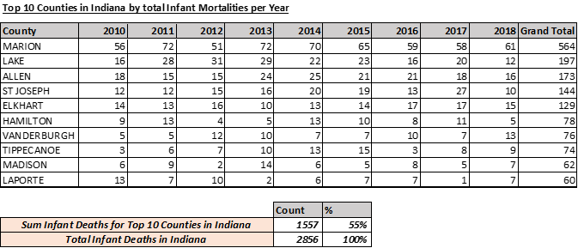
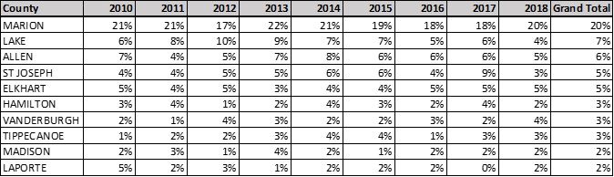
Appendix 1

Slide 18
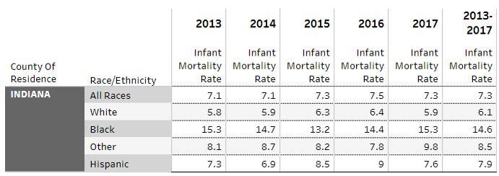
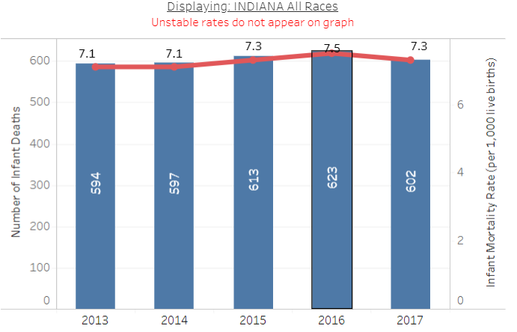
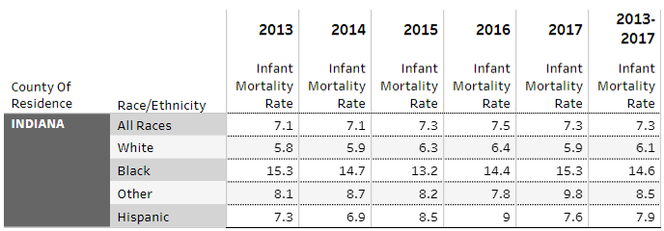
Appendix 2
As per Indiana State Department health the maximum infant mortality was seen in blacks with a whooping figure of 14.6%

Slide 19
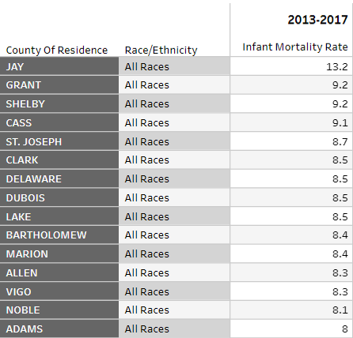
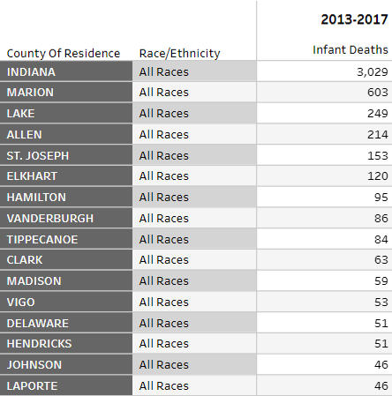
Appendix 3

